Slide 1


E-Vision Pricing Model
An AI-Powered Multimodal Solution for Intelligent Product Pricing in E-Commerce
Department of Computer Science and Engineering
Institute of Engineering & Technology (IET), Lucknow
Submitted by:
Bhawna Chauhan (2300520109001)
Nadia Kamar (2200520100040)
Guided by:
Dr. Manik Chandra
Mr. Rakesh Gautam

Slide 2
AGENDA
01
Introduction
02
Motivation
03
Objective & Problem Statement
04
Literature Survey
05
Methodology
06
Implementation
07
Result
08
Conclusion
09
Future Scope
10
References

Slide 3



INTRODUCTION
Accurate e-commerce pricing is key, but traditional competitor-based algorithms fail for unique, custom, or bundled products (like gourmet baskets). This results in the Cold-Start Pricing Problem: non-standard items lack competitor data, leading to inaccurate pricing that damages profit or sales. The E-Vision Pricing Model solves this using an intrinsic valuation strategy. Instead of external data, it analyzes product descriptions and images (packaging, quantity, presentation) to predict a fair price based on inherent worth.
Our Solution
E-Vision Pricing Model
A revolutionary approach that calculates Intrinsic Value by analyzing what a product contains and how it appears, rather than relying on external market comparisons.
Multimodal Data Dependency
Value is captured by merging Textual Descriptions (ingredients, brand) with Visual Cues (packaging, design).

Slide 4
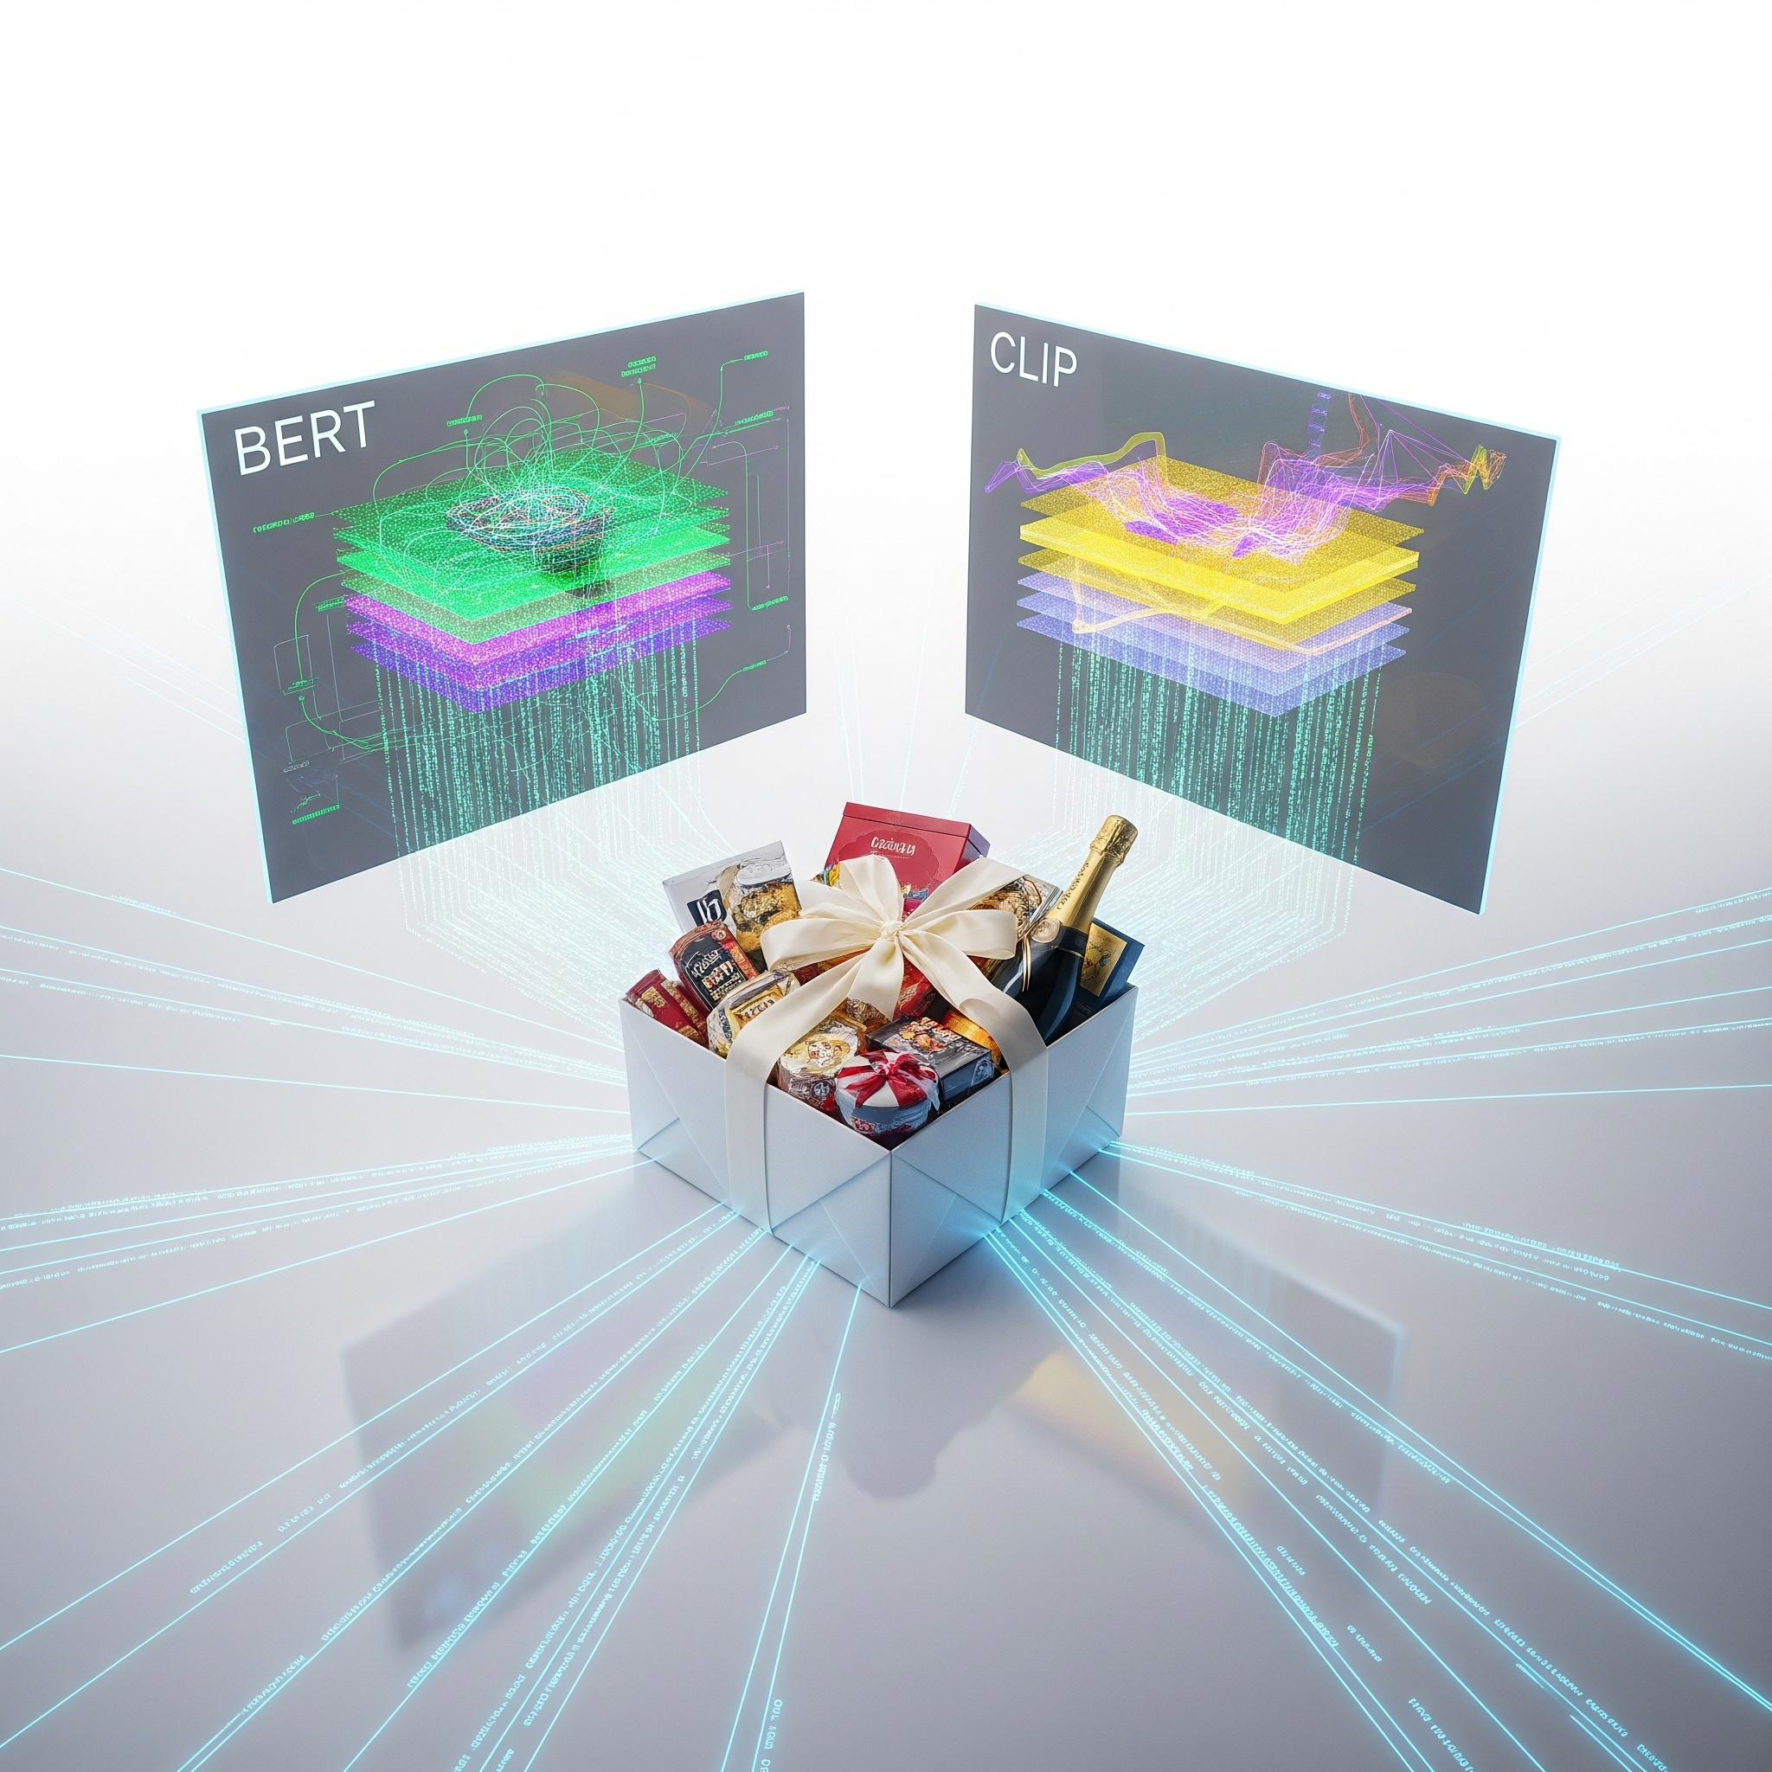
OBJECTIVE & PROBLEM STATEMENT
The Problem
The Cold-Start Pricing Crisis
Traditional models fail for unique products like gourmet hampers and custom bundles due to a lack of direct market benchmarks. This leads to arbitrary pricing that either kills sales or destroys profit margins.
Our Mission
Solve Cold-Start: Establish accurate price forecasts based solely on intrinsic product characteristics.
Unified Representation: Integrate BERT (text) and CLIP (visuals) for consistent valuation.
Mitigate Subjectivity: Replace manual guesswork with a data-driven, scalable pricing strategy.

Slide 5
LITERATURE SURVEY
Key Foundations
References
Findings
Methods Used
Important Features
Drawbacks
Devlin et al. (2019)
Bidirectional pre-training improves language understanding.
BERT (Transformer Encoder)
Contextualized embeddings; multi-head attention.
Computationally heavy; high-dimensional output.
Radford et al. (2021)
Language supervision trains transferable visual models.
CLIP (Contrastive Learning)
Shared embedding space; zero-shot capabilities.
Requires massive paired image-text datasets.
He et al. (2016)
Residual learning allows training ultra-deep networks.
ResNet (Deep Residual Networks)
Skip connections; accurate feature extraction.
Struggles with semantics without accompanying text.
Zhang et al. (2022)
Multimodal fusion improves product understanding.
Multimodal Fusion
Holistic visual and textual capture.
Requires careful tuning to balance modalities.

Slide 6
PROPOSED METHODOLOGY
The E-Vision Pricing Model employs a sophisticated multimodal deep learning architecture that processes product information through two parallel neural pathways, mimicking how human experts evaluate products by both reading specifications and visually assessing appearance.
01. DATA COLLECTION
02. EXTRACTION
03. FEATURE FUSION
04. PRICE PREDICTION
System receives raw product data:
High-res images
Detailed catalog descriptions
Bullet points
Numerical attributes (weight, volume)
Text Branch (BERT):
Semantic meaning, brand quality, and quantities.
Image Branch (CLIP):
Packaging quality, branding, and aesthetic appeal.
BERT (768-d) and CLIP (512-d) embeddings are concatenated.
Processed through fusion layers to create a unified product representation.
Regression head analyzes fused features to generate final prediction.
Learns complex relationships between product characteristics and market value.

Slide 7

MULTIMODAL FEATURE EXTRACTION
STEP 01
PROCESSING
image
Image Branch (CLIP)
Extracts packaging quality, branding, and aesthetic appeal.
Output: 512-dim Visual Features
description
Text Branch (BERT)
Analyzes semantic meaning, brand quality, and product specifications.
Output: 768-dim Textual Features
STEP 02
FUSION
MULTIMODAL CONCATENATION LAYER
STEP 03
PREDICTION
MLP Regression Head
Analyzes fused features to learn complex relationships and generate the final market value estimate.
payments
FINAL PRICE

Slide 8
IMPLEMENTATION: TOOLS & TECHNOLOGIES
CORE DATA SCIENCE
NLP & FEATURE EXTRACTION
DEEP LEARNING & OPTIMIZATION
Python Framework
Primary language for high-performance numerical computing and matrix calculations.
Pandas: Large-scale dataset ingestion and rigorous data cleaning.
NumPy: Efficient storage of high-dimensional tensors and vector operations.
Matplotlib/Seaborn: Visual diagnostic tools for loss trajectories and price variance.
Semantic & Visual Extraction
Advanced processing pipelines for unstructured product catalog decoding.
NLTK: Tokenization and stop-word elimination for text normalization.
Sentence Transformers: Generating 384-d semantic embeddings via MiniLM.
Regex: Custom parsing for Item Name, Quantity, and Brand ID.
PIL: Standardization of RGB product images to 224x224 tensors.
Predictive Architecture
Multimodal fusion engine for final price regression.
PyTorch: Construction of MultimodalFusionMLP and attention layers.
AdamW Optimizer: Adaptive weight decay (lr: 2e-5 to 5e-4).
Hardware Acceleration: GPU-driven training via CUDA and Apple MPS.
Scikit-Learn: K-Fold cross-validation and Robust Scaling of inputs.

Slide 9
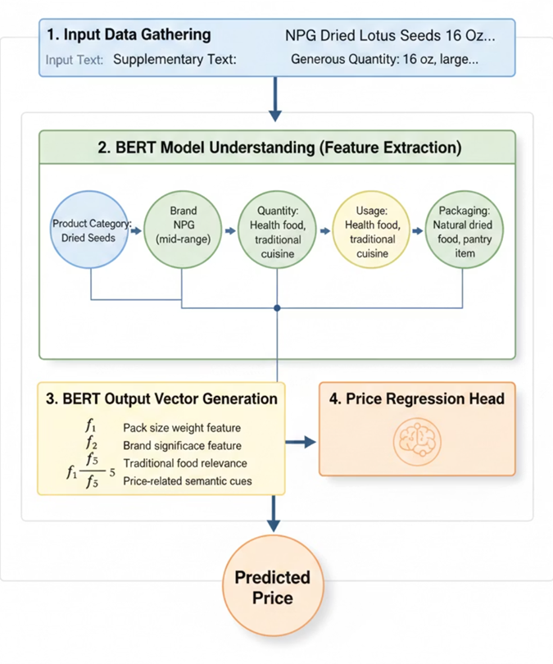
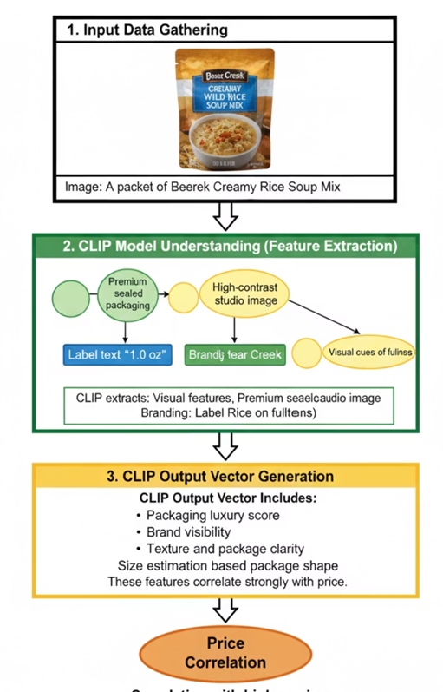
MULTIMODAL PIPELINE VISUALIZATION
BERT TEXT ANALYSIS PIPELINE
CLIP VISUAL ANALYSIS PIPELINE

Slide 10
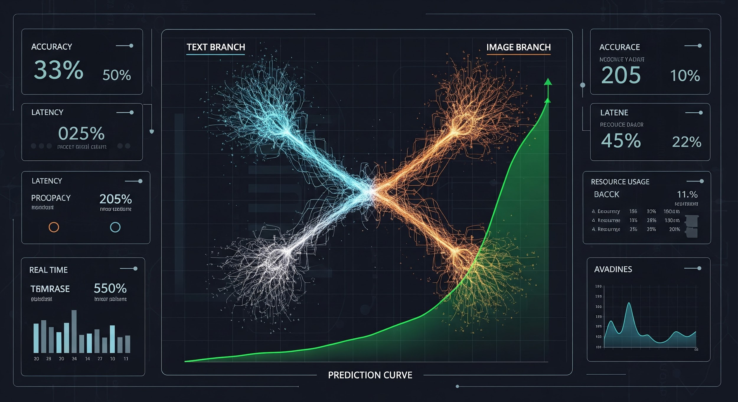
RESULTS & KEY OUTCOMES
MODEL PERFORMANCE
MULTIMODAL SUPERIORITY
BUSINESS INTELLIGENCE
~60% SMAPE
PREDICTION ACCURACY
SYNERGY
COMBINATION ENGINE
Symmetric Mean Absolute Percentage Error
Rigorous evaluation across 5-Fold Cross-Validation.
Decodes complex correlations between physical appearance and value.
High generalizability on unseen, non-standard product samples.
Optimal Product Bundling
Identifies complementary items via embedding cosine similarity.
Strategic Discounting: Optimizes bundle prices based on affordability tiers.
Maximizes platform conversion and fair market value.
Intrinsic Value Extraction
Textual (BERT): Granular details on quantity and brand prestige.
Visual (CLIP): Packaging luxury and aesthetic appeal assessment.
Multimodal fusion compensates for noisy catalog descriptions.

Slide 11
FUTURE SCOPE & SCALABILITY
PHASE 1: FOUNDATION & LOCAL
PHASE 2: INTELLIGENT AGENTS
PHASE 3: GLOBAL ADAPTATION
01. Multi-Language Support
Fine-tuning BERT for regional languages like Hindi to empower local sellers.
02. Real-Time Market Feedback
Integrating dynamic demand signals using Reinforcement Learning.
03. Mobile "Snap & Price"
Dedicated app for on-the-go valuation via image capture.
04. Agentic Architecture
Scaling to multi-agent systems for forecasting and inventory tasks.
05. Graph Neural Networks
Using GNNs for combinatorial optimization of synergistic product bundles.
06. Enterprise-Level Scalability
Transitioning from research prototype to high-throughput cloud solution.
07. Global Market Adaptation
Customizing value signals for regional currency and market norms.
08. Hybrid Pricing Agent
Merging intrinsic worth with competitive benchmarks for hybrid valuation.

Slide 12
REFERENCES
[1] Devlin, J., Chang, M., Lee, K., & Toutanova, K. (2019). BERT: Pre-training of Deep Bidirectional Transformers for Language Understanding. Proceedings of NAACL-HLT.
[2] Radford, A., Kim, J. W., Hallacy, C., et al. (2021). Learning Transferable Visual Models From Natural Language Supervision (CLIP). OpenAI.
[3] Vaswani, A., Shazeer, N., Parmar, N., et al. (2017). Attention Is All You Need. Advances in Neural Information Processing Systems (NeurIPS).
[4] He, K., Zhang, X., Ren, S., & Sun, J. (2016). Deep Residual Learning for Image Recognition. CVPR.
[5] Tan, M., & Le, Q. (2019). EfficientNet: Rethinking Model Scaling for Convolutional Neural Networks. ICML.
[6] Belo, O., & Pereira, D. (2021). Data-Driven Dynamic Pricing Models for E-Commerce: A Survey. Journal of Retail Analytics.
[7] Li, X., Yin, X., & Li, C. (2020). Oscar: Object-Semantics Aligned Pre-training for Vision-Language Tasks. ECCV.
[8] Zhang, Y., Zhao, X., & Chen, L. (2022). Multimodal Fusion Approaches for Product Understanding in E-Commerce. ACM Transactions on Information Systems.

Slide 13

THANK YOU
Questions? We're happy to discuss.
Presented by:
Bhawna Chauhan
&
Nadia Kamar

